Slide 1
Applied Data Science Capstone (IBM) Opening a New Restaurant in Delhi, India
By: Anirban Pal
July, 2020

Slide 2
Business Problem
High Competition
Market Demand
Preferred Location

Slide 3
Required Data
List of neighbourhood in Delhi, India (Wikipedia)
Latitude and longitude coordinates of the neighbourhoods (using Geocoder package)
Venue data by Foursquare API

Slide 4
Methodology
Libraries and package importing
Web scrapping of the Wikipedia page
Getting latitude and longitude using Geocoder
Get venue data using Foursquare API
Group data and filter for restaurants venue
Clusters the neighbourhoods using K-means
Visualize the map using Folium

Slide 5
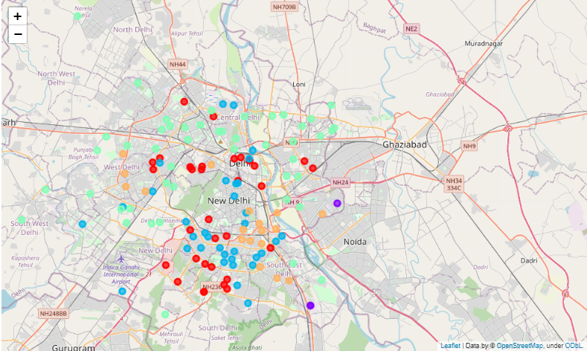
Results
Categorized into 5 clusters ( 0 - 4 ) among which cluster 3 is most suitable

Slide 6
Discussion
Most suitable cluster is cluster – 3
The order of suitability (Less to High) is cluster 1> cluster 4> cluster 2> cluster 0> cluster 3

Slide 7


